Slide 1

BeSafe: IoT Based Safety Band
ICSMDI 2022
Authors: Ganesh Jambuka, Krishi Shah, Riddhi Shah, Anagha Aher
College: A.P Shah Institute of Technology
Department: IT
University of Mumbai

Slide 2

Contents
Introduction
Abstract
Objectives
Literature Review
Problem Definition
Scope
Technology stack
Proposed System
Result
Conclusion
References
Paper Publication
ICSMDI 2022

Slide 3

Introduction
Our approach.
What we have implemented:
An IoT Safety Band.
A Flutter Application.
Logs/Records stored in Cloud.
ICSMDI 2022

Slide 4

Abstract
ICSMDI 2022
Women Safety has become a major issue.
To help everyone when they need assistance.
What we can do about it.

Slide 5
Objectives
To develop a cross-platform application.
To send a google map url link.
To store data in cloud.
To analyze data for data visualization.
ICSMDI 2022

Slide 6
Literature Reviews
ICSMDI 2022

Slide 7
Raspberry Pi Based Smart Wearable Device for Women Safety using GPS and GSM Technology, (2020).
by Dhiraj Sunehra, SMIEEE, V. Sai Sreshta, V. Shashank, B. Uday Kumar Goud.
For safety and security it sends a buzzer alert to people who are close to the user.
It locates the user using the GPS transmits via SMS to the emergency contact and police using the GSM.
It interfaces with a USBWeb Camera and sends an e-mail.
Instead of using raspberry pi, we will use arduino nano which is smaller in size.
And creating own cross platform application with all the features in it.
Methodology
Learnings
ICSMDI 2022

Slide 8
WOMEN’S SAFETY SYSTEM BY VOICE RECOGNITION, (2020).
by V. Mishra, N. Shivankar, S. Gadpayle, S. Shinde, M. A. Khan, and S. Zunke.
The proposed system uses SQL for the database, voice recorder, and GPS for getting coordinates.
The application is activated when the user shakes the phone, uses voice, or presses the button present in it. It sends the latitude and longitude coordinates to the contacts via SMS and records audio for proof.
Instead of sending gps we could send google map url link.
Android security doesn’t allow to continuously listen to voice.
Methodology
Learnings
ICSMDI 2022

Slide 9
Safety Solution for Women Using Smart Band and CWS App, (2020).
by A. Z. M. Tahmidul Kabir, Al Mamun Mizan, Tasnuva Tasneem.
The proposed methodology is an Android app and an Internet of Things (IoT) device to make women’s movement safer.
The app also provides the user with the location of the nearest safe zone. The app can transmit a notification to the nearest police station and volunteer support.
To show directions for nearby safe locations like Hospitals, Police Stations or Crowded areas.
To store location data in cloud for data analysis.
Methodology
Learnings
ICSMDI 2022

Slide 10
Problem Definition
Problem Identified:
The free movement of women are being hampered by abuse.
The person who is in unmovable situation due to an accident or alone who needs help.
Solution Proposed:
We proposed to make an app that helps the women to reach her family with single a click.
We are also planning to create a system so, a person can contact the concerned authority by a single click by sending his/her location.

Slide 11
Scope
Safety band cannot only be used by women but also can be used by men.
The victim can send the location without the attacker having any idea about it.
This band can be used by anyone to contact the immediate or extended family and friends in case of emergency.

Slide 12
Technology Stack
Hardware:
Arduino nano
GSM SIM800L
GPS
Push Button
Buzzer
Software:
Firebase
Flutter
Android studio, Arduino IDE

Slide 13
Proposed System
ICSMDI 2022

Slide 14
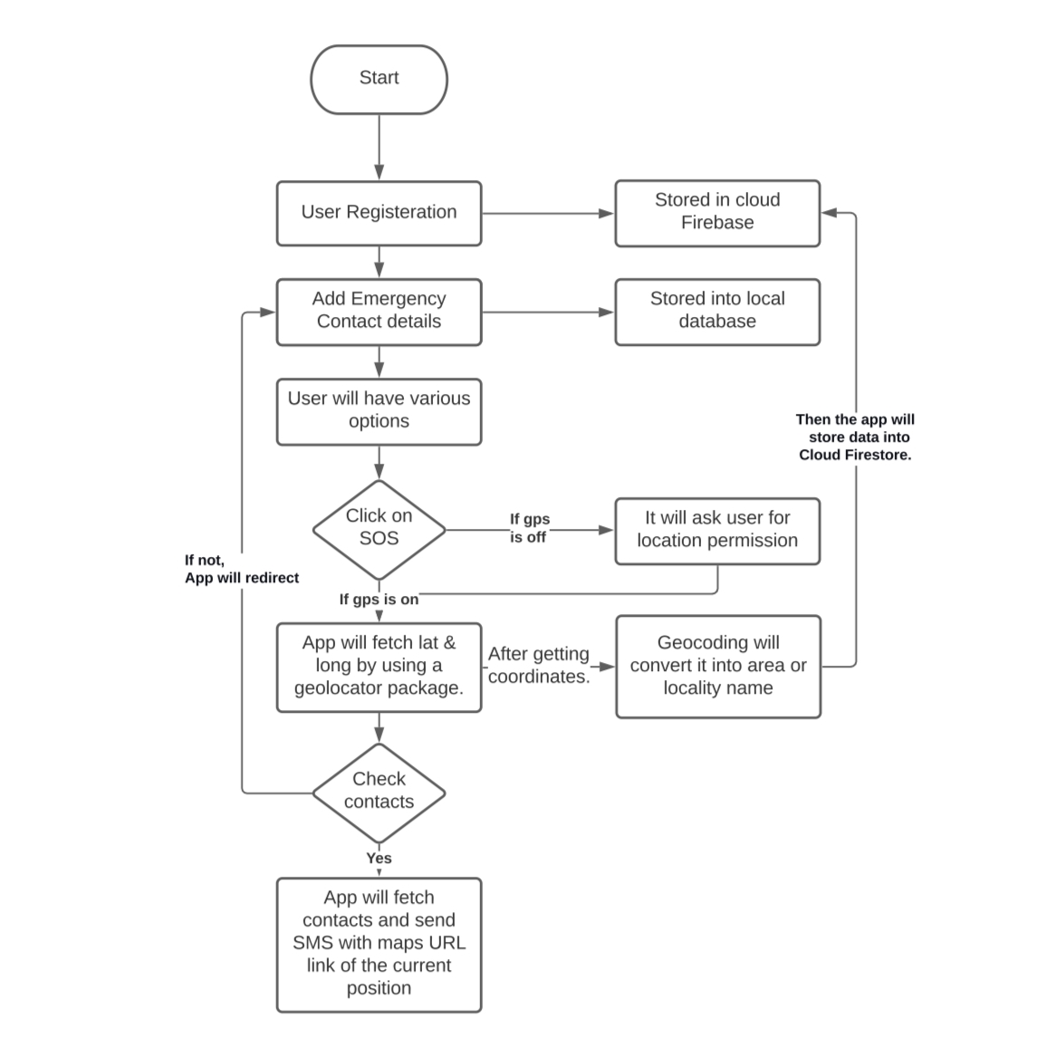
Flow of App
ICSMDI 2022

Slide 15
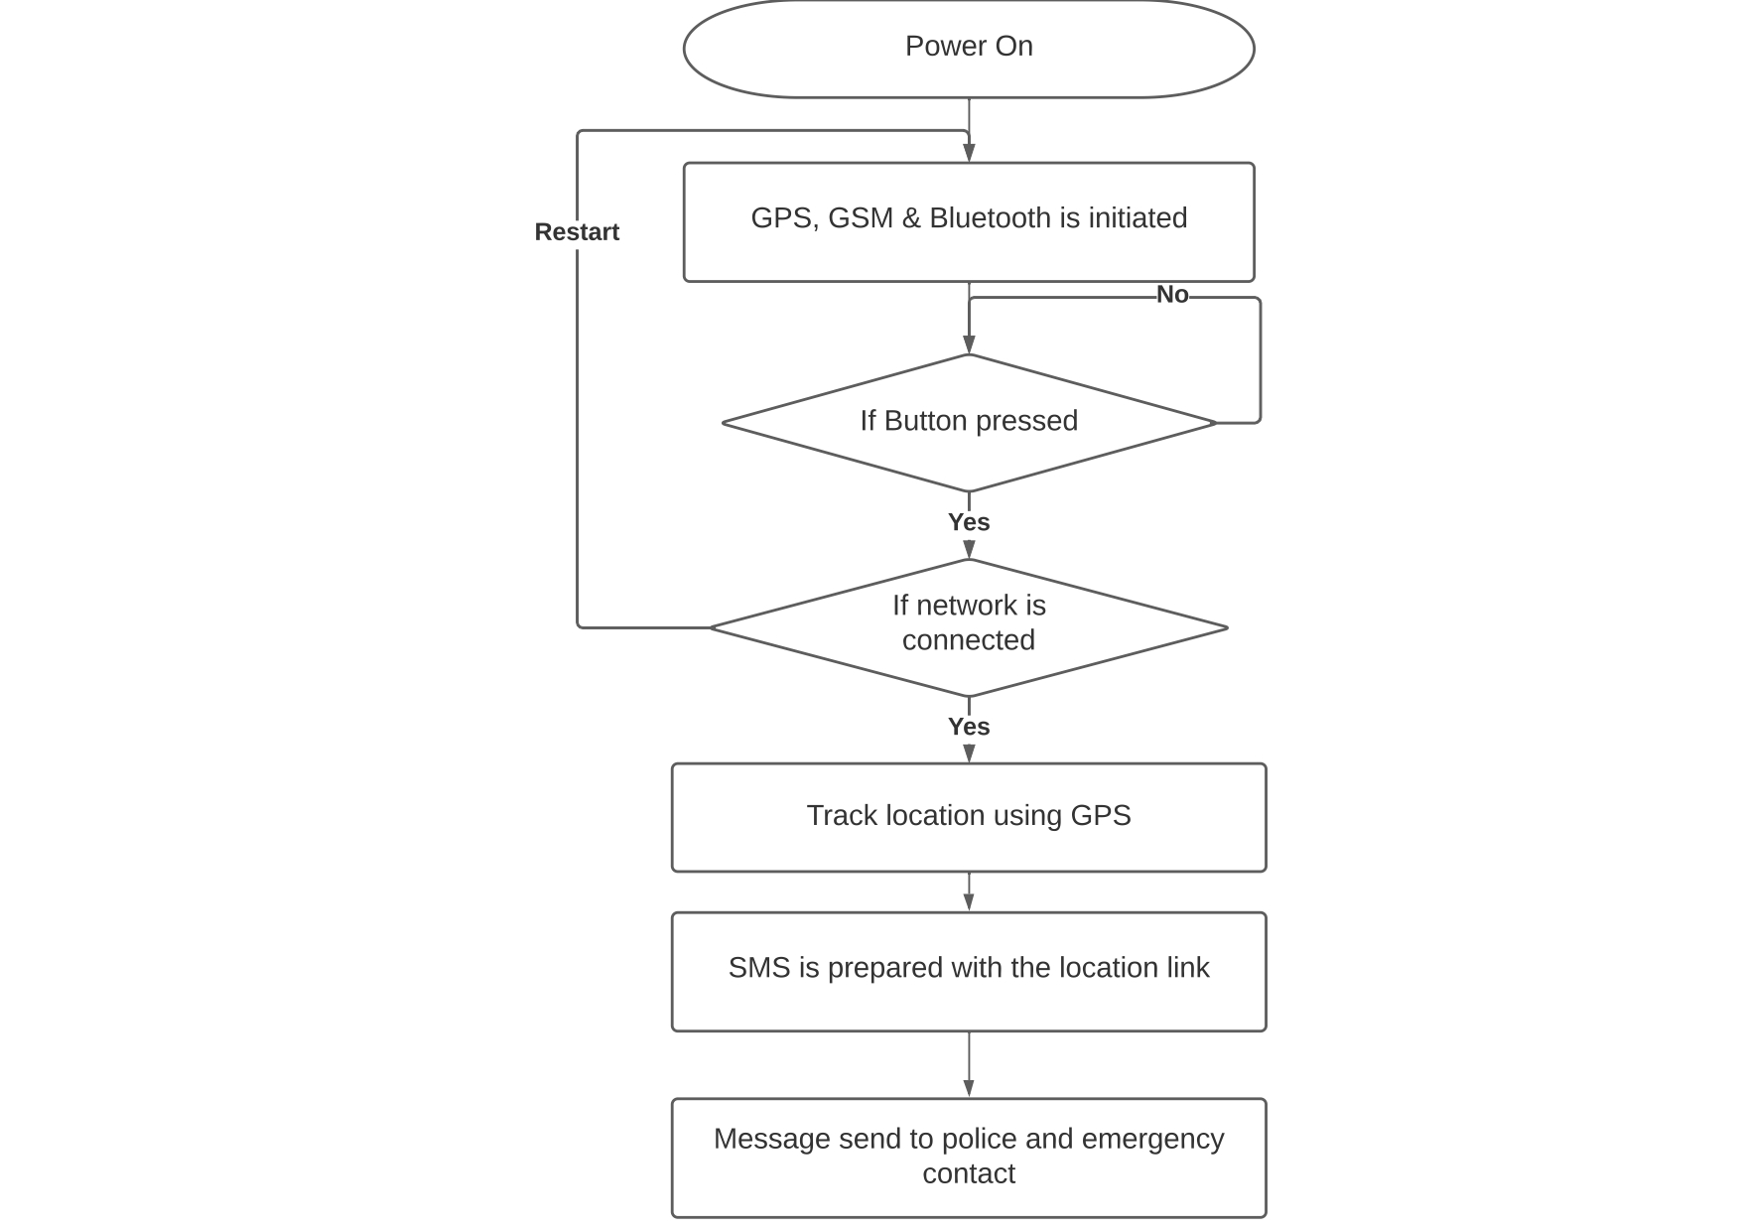
Flow of Band
ICSMDI 2022

Slide 16
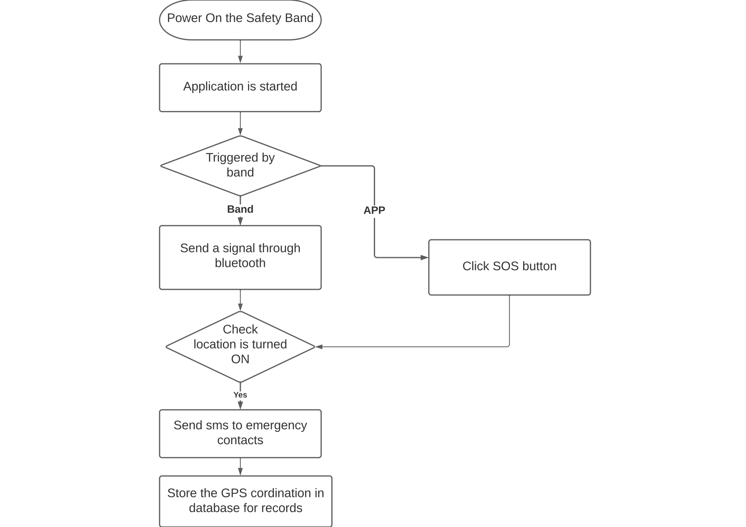
Flow of App and Band
ICSMDI 2022

Slide 17

Results
ICSMDI 2022

Slide 18

Software Implementation
ICSMDI 2022

Slide 19


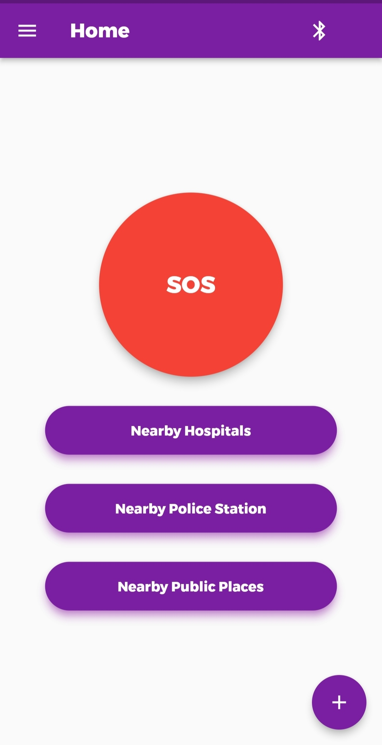
ICSMDI 2022

Slide 20
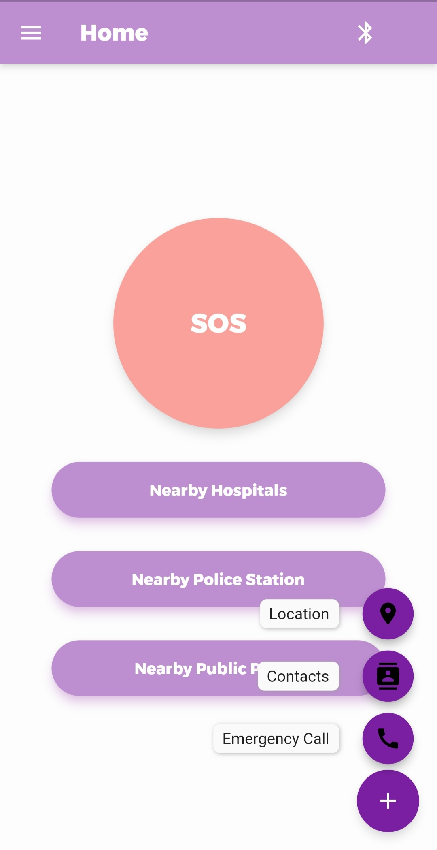


ICSMDI 2022

Slide 21
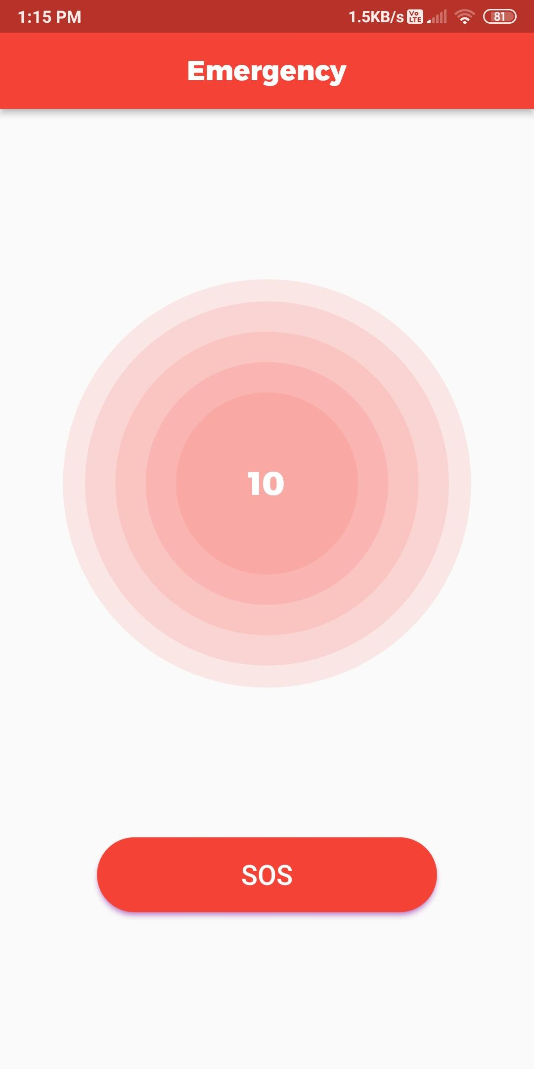
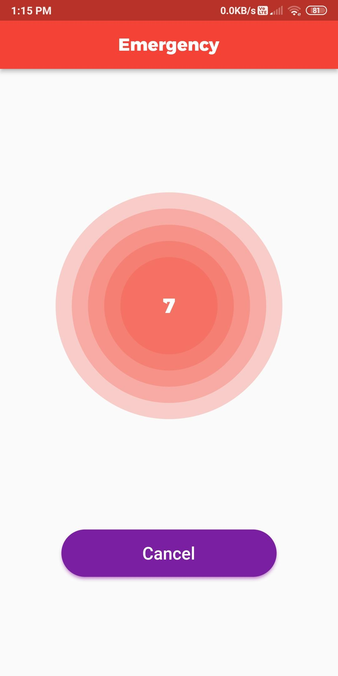
ICSMDI 2022

Slide 22


ICSMDI 2022

Slide 23
Hardware Implementation
ICSMDI 2022

Slide 24
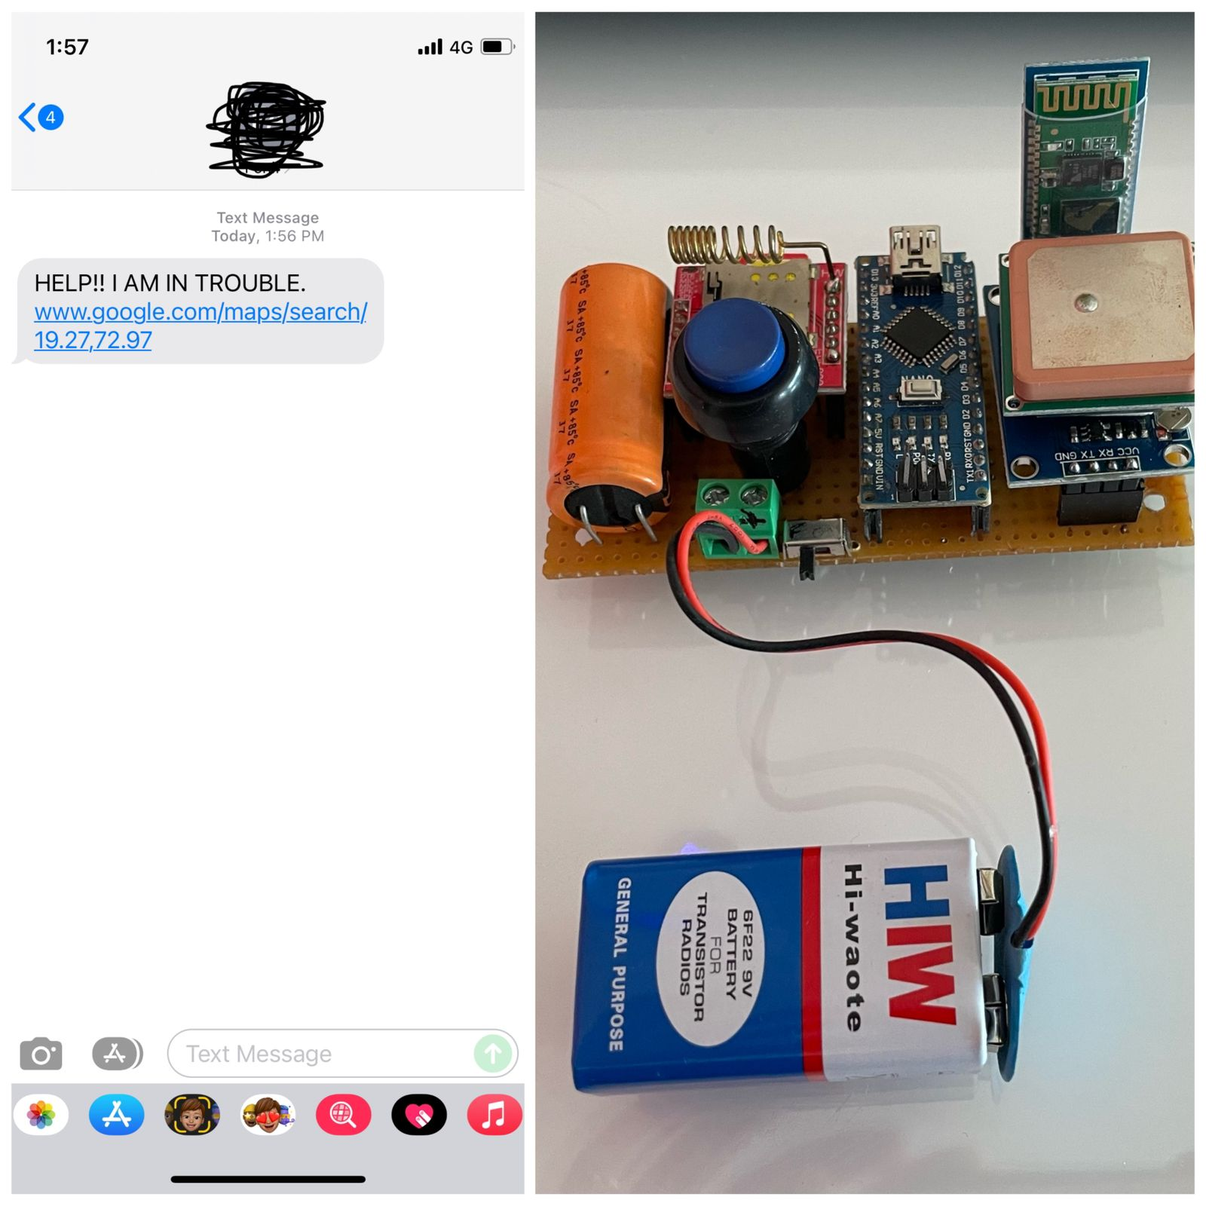
ICSMDI 2022

Slide 25


Checklist:
Cross Platform Application
Data Analysis
IoT Safety Band
Backend Support
ICSMDI 2022

Slide 26
Conclusion
Our intentions
To make women movement safer and everybody else.
Maximizing the safety of women.
ICSMDI 2022

Slide 27
References
ICSMDI 2022
[1] Pandey, Saumya, et al. "Reach360: A comprehensive safety solution." 2017 Tenth International Conference on Contemporary Computing (IC3). IEEE, 2017
[2] Sogi, Navya R., et al. "SMARISA: a raspberry pi based smart ring for women safety using IoT." 2018 International Conference on Inventive Research in Computing Applications (ICIRCA). IEEE, 2018.
[3] Sunehra, Dhiraj, et al. "Raspberry Pi Based Smart Wearable Device for Women Safety using GPS and GSM Technology." 2020 IEEE International Conference for Innovation in Technology (INOCON). IEEE, 2020.
[4] Khandoker, Rabbina Ridan, et al. "LIFECRAFT: an android based application system for women safety." 2019 International Conference on Sustainable Technologies for Industry 4.0 (STI). IEEE, 2019.
[5] Nagamma, H. "IoT based smart security gadget for women’s safety." 2019 1st international conference on advances in information technology (ICAIT). IEEE, 2019.
[6] Khanam, Shaista, and Trupti Shah. "Self Defence Device with GSM alert and GPS tracking with fingerprint verification for women safety." 2019 3rd International conference on Electronics, Communication and Aerospace Technology (ICECA). IEEE, 2019.
[7] Sen, Trisha, et al. "ProTecht–Implementation of an IoT based 3–Way Women Safety Device." 2019 3rd International conference on Electronics, Communication and Aerospace Technology (ICECA). IEEE, 2019.

Slide 28
References
ICSMDI 2022
[8] Anand, Adithya, et al. "Ally-A Crowdsourced Distress Signal App." 2020 International Conference on Communication and Signal Processing (ICCSP). IEEE, 2020.
[9] Chaudhary, Harshal, Ranjana Zinjore, and Varsha Pathak. "Parent-Hook: A Child Tracking System based on Cloud URL." 2020 International Conference on Smart Innovations in Design, Environment, Management, Planning and Computing (ICSIDEMPC). IEEE, 2020.
[10] Fernandez, Zully Amairany Montiel, et al. "Challenges of Smart Cities: How Smartphone Apps Can Improve the Safety of Women." 2020 4th International Conference on Smart Grid and Smart Cities (ICSGSC). IEEE, 2020.
[11] Kabir, AZM Tahmidul, and Tasnuva Tasneem. "Safety Solution for women using Smart band and CWS App." 2020 17th International Conference on Electrical Engineering/Electronics, Computer, Telecommunications and Information Technology (ECTI-CON). IEEE, 2020.
[12] Mishra, Vinay, et al. "Women’s safety system by voice recognition." 2020 IEEE International Students' Conference on Electrical, Electronics and Computer Science (SCEECS). IEEE, 2020.
[13] Savla, Dev V., et al. "ResQ-Smart Safety Band Automated heart rate and fall monitoring system." 2020 Fourth International Conference on I-SMAC (IoT in Social, Mobile, Analytics and Cloud)(I-SMAC). IEEE, 2020.
[14] Sunehra, Dhiraj, et al. "Raspberry Pi Based Smart Wearable Device for Women Safety using GPS and GSM Technology." 2020 IEEE International Conference for Innovation in Technology (INOCON). IEEE, 2020.
[15] Venkatesh, K., et al. "IoT based Unified approach for Women safety alert using GSM." 2021 Third International Conference on Intelligent Communication Technologies and Virtual Mobile Networks (ICICV). IEEE, 2021.

Slide 29
Paper Publication
ICSMDI 2022
[Paper entitled “BeSafe: IoT Based Safety Band” is presented at “International Con-
ference on Smart Data Intelligence (ICSMDI 2022)” by “Ganesh Jambuka, Krishi
Shah, Riddhi Shah”.

